Slide 1
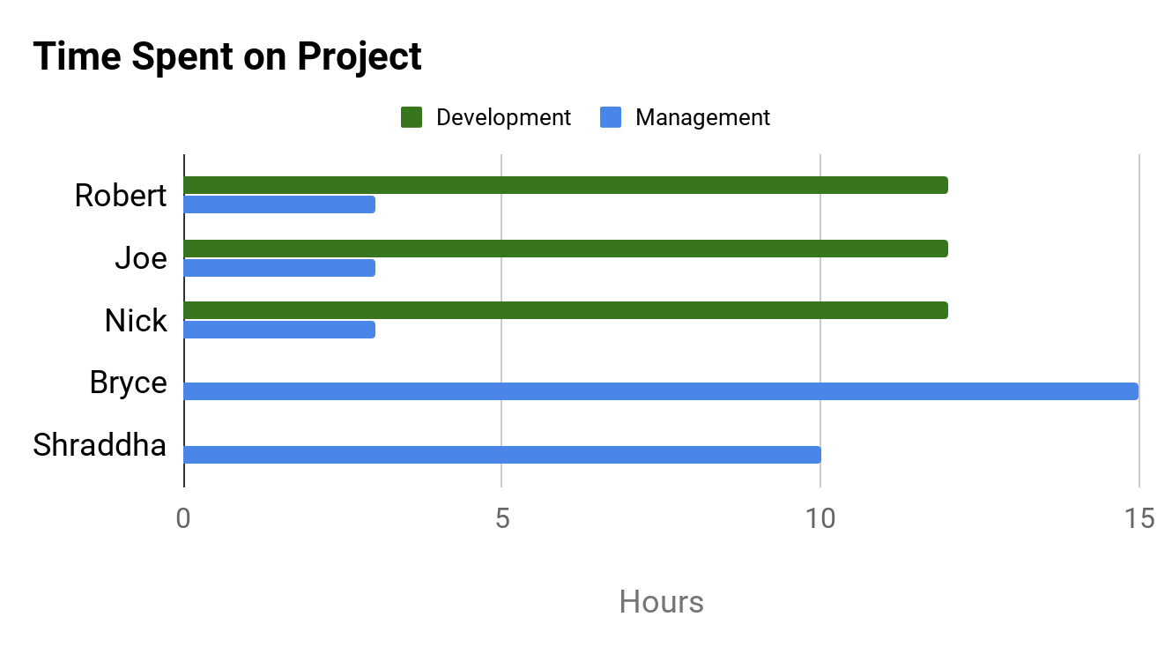
PROJECT DASHBOARD: HAX CMS MICROSERVICE
TEAM: #1
DATE: 16-FEB-2020
COMPLETED TASKS
On Target | At Risk | Attention Needed | Not Applicable
PROJECT STATUS
KEY PERFORMANCE INDICATORS
Met with Bryan Ollendyke to discuss project requirements
Reviewed Docker as a team
Reviewed HAX CMS site
On Target | At Risk | Attention Needed | Not Applicable
Overall: On Target
Time: On Target
CURRENT TASKS
Scope: On Target
Review PanDoc
Begin initial design mockups
Prepare plan for the main development phase
Cost: No Budget
RISK STATUS
Task | Progress
Requirement Gathering
Complete Gantt Chart
Potential User Interviews
On Target | At Risk | Attention Needed | Not Applicable
ISSUES NEEDING ATTENTION
Risk 1: Lack of Developer Assistance
75%
No issues at this time
Risk 2: Project Pace
25%
Risk 3: GitHub Compatibility
Risk 4: Scope Creep
25%

